Slide 1
API Usecases
Notes:
This is an example of a Title Slide. We need to convey Life Is On in everything we do, so try to lead with compelling images that are vibrant, authentic, and human. The human element should be apparent and within the context of a segment that we touch.
To keep this PowerPoint template file size reduced, we included a small library of image choices in the Slide Master (under View). You can also get them from the SE Asset Library: https://schneiderelectric.telescopeondemand.com

Slide 2
MYSE-PriceAndAvailabilityMultiple-V1
Overview: The aim of Price and Availability Multiple API is to provide products price and availability information for a given user in a given business unit (mySE country).
Business Value Delivered:
A user can have access to multiple accounts in mySE.
API is designed for seamless and one of the highvalue, secure and reusable . Since user will get validated in IDMS and given access to multiple accounts like his home account and multiple account linked to his home account .
API ensure getting information from multiple account like home account and all associate account like order management .

Slide 3
Distributor-SPJ-Rebate-V2
Overview: Distributor-SPJ-Rebate API will give distributors the ability to retrieve SPJ rebate information seamlessly in their ecosystem. This is available only for NAM distributors using SE Advantage application for quotation management
Business Value Delivered:
API redesigned as part of the new architecture ESB layer removed for this API flow . Complete ESB mash up code implemented in Apigee layer.
API Provide the updated of rebates information to the distributors in the US.

Slide 4
Quotation for Digital Offers
Overview: The QDO project leveraged the API First approach to quickly pilot a microservices-based quotation solution. It combines many existing APIs to create a holistic solution.
Business Value Delivered:
Time to quote for SE’s new Digital Offers reduced from 4+ days to minutes. It will support Assets Under Management with a target of 40% growth.
Enables country sales teams to grow digital offer sales
Enables offer managers to mature and industrialize their digital offerings and pricing models.

Slide 5
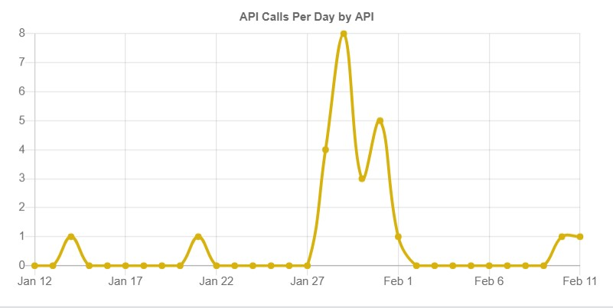
Events – Apple.inc usecase
Overview: This is a general purpose API which accepts events from pre-registered source systems to deliver events from them to one or more Schneider Electric systems. It is implemented to satisfy a mandate by Apple, Inc. to use a vendor system called Service Channel to automate field service callout requests and their check in/out time logging.
Business Value Delivered:
The new API platform was the only viable and feasible way to quickly deliver this solution.
It provides a low barrier-to-entry to integrate external data sources into our IT ecosystem, where we adapt to the customer-preferred format, rather than requiring them to adapt to our standards. This mode is suited for VIP customers.
This API is designed to be highly reusable and secure.

Slide 6
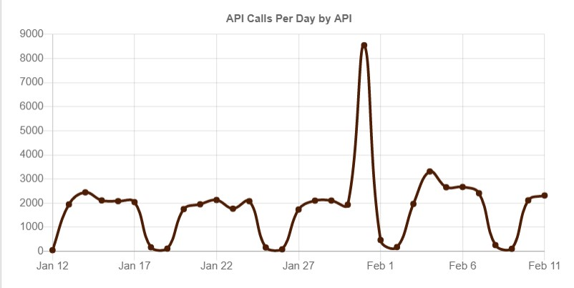
PurchaseOrder for SecurePower
Overview: This API enables near-real-time updates of ERP Sales Orders and Service Contracts to Customer Purchase Orders in ServiceNow.
It alleviates manual order intake and provides accurate processing metrics, enabling continuous process improvements and efficient handling of customer orders.
Business Value Delivered:
The Customer Purchase Order Management solution replaces a 15-year old Lotus Notes database that processes an estimated $3 billion USD annually, the majority of Secure Power’s revenue.
It was deemed business-critical to deploy the Oracle-to-ServiceNow solution in order to mitigate the risk of failure and lost revenue due to on-going issues with the existing legacy solution.

Slide 7
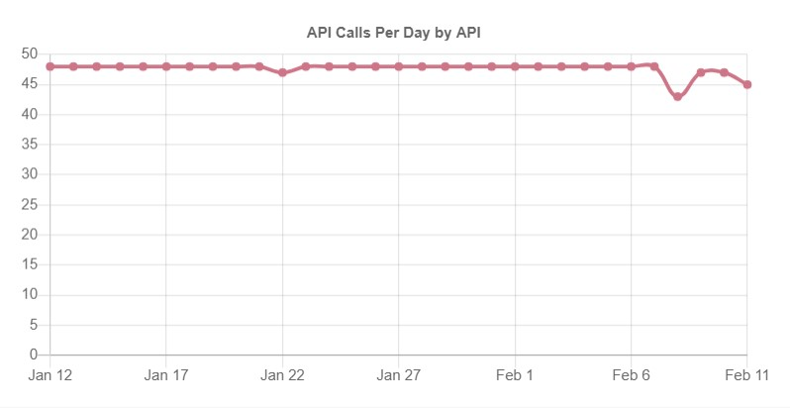

Partner Opportunities
Overview: This API enables key distributors to generate and manage sales opportunities. It is used to connect mySchneider Opportunity with Graybar’s Customer details in US.
Business Value Delivered:
This opportunity demonstrated collaboration between Schneider Electric and Graybar to CEOs of both companies.
This API helped integrate real-time data exchange between Graybar’s CRM and Schneider Electric’s PRM.
The API management platform’s analytics allow for insights into the usage of the API resulting in strategies based on opportunities.

Slide 8
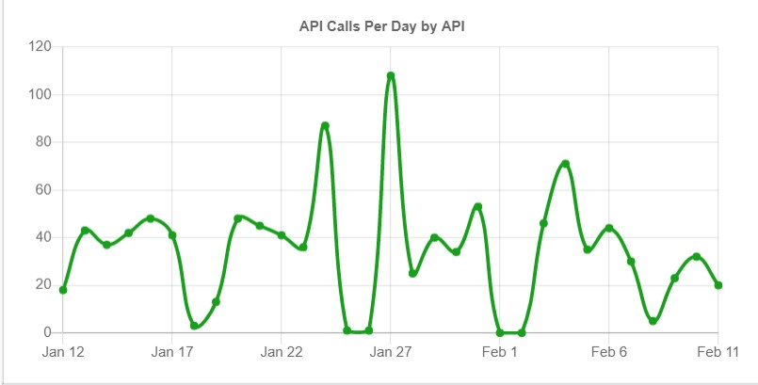

Language Translator
Overview : Microsoft Translator API is a language translation service that can be integrated into applications to support website localization, e-commerce, customer support, messaging applications or internal communication.
bFO is a subscriber to this API. This API is chargeable by Microsoft based on the number of words translated.
Business Value Delivered:
Problem was that Azure provided only 1 key and we had 5 consumers (It is expected to grow further). The new API management platform enabled us to provide unique credentials to each application and track their usage individually.
Previous system relied on Azure for billing. With moving to the new API management platform, bFO could compare billing information provided by Azure against that from the new API management platform statistics.

Slide 9
mySE4Search
Overview: This API exposes an existing application to the consumers outside SE network. It is built for Guided mySE search which is a valuable component to the mySE system.
Business Value Delivered:
Guided Search API is a key part of mySE performance improvement program. Its introduction will increase sales via the digital mySE channel and will lead to substantial financial benefits.
Exposing this API to the internet was a need for mySE to use it. The new API management platform enabled the project team to accomplish this quickly and securely. The alternative solution would have taken more time and effort resulting in higher development costs.

Slide 10
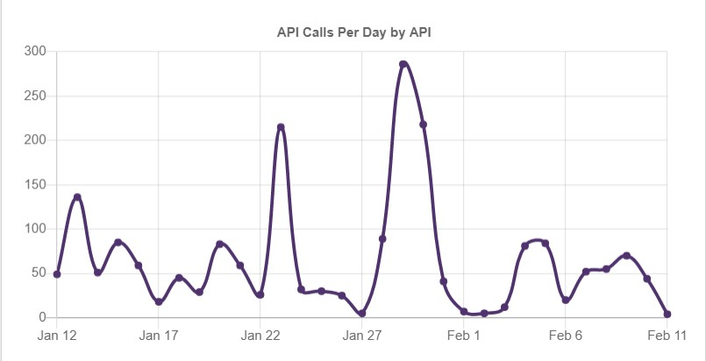
Chatbot and LiveAgent
Overview: Chatbot and LiveAgent are two APIs delivered for a troubleshooting Chatbot solution on apc.com. These APIs are needed to underpin the solution to troubleshoot APC Back-UPS devices. First API sends automated responses from a Bot and the second API connects to a real person.
Business Value Delivered:
The new API platform ensured that this API accessed the Crown Jewel application bFO in a secure manner.
Automatically creates cases in bFO from chat conversations.
API management platform analytics could provide business insights into products that need improvement.
Notes:
This is an example of a Text Slide. Reference the different layout options in the Slide Master (under the View tab) for different variations. Remember, our new Brand Guidelines call for clean and simple messages and design. Reference the PowerPoint Guidelines on the Brand Book for tips and useful information on creating effective presentations.

Slide 11
Notes:
Closing slide

